Slide 1
Microwave Theory and Techniques
18ECC302J
Session 1
Introduction to Microwaves and optical communications
1
Notes:
Some Studies on Dielectric Resonator Antennas

Slide 2
Introduction to Microwaves

Slide 3
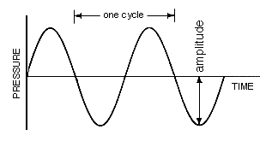
Introduction
Wave: A disturbance that propagates from one point in a medium to other points without giving the medium as a whole, any permanent displacement.
EM wave: A radiant energy flow produced by oscillation of an electric charge. EM consists of vibrating electric and magnetic fields that move at the speed at light.
Wavelength: the physical distance between two points having same phase in two consecutive cycles of a periodic wave alona a line in the direction of propagation.

Slide 4
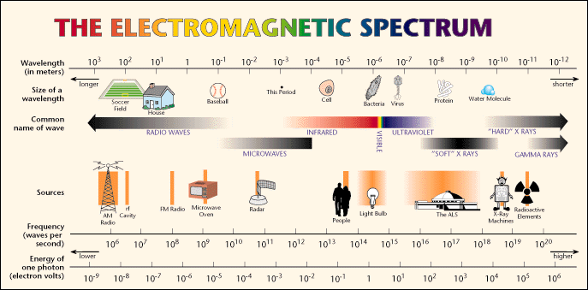


EM Spectrum
800-900 MHz
50-600MHz

Slide 5
Frequency Band Designation
Wavelength Frequency band Designation Typical services
30000-10000m 3-30KHz VLF Navigation, Sonar
10000-1000m 30-300KHz LF Navigational aids
1000-100m 300-3MHz MF AM, Radio
100-10m 3-30MHz HF Telephone,
Telegraph, fascimile
10-100cm 30-300MHz VHF TV,FM, Air traffic control,
police, mobile radio
100-10cm 300-3GHz UHF TV, Satellite, Radar
10-1cm 3-30GHz SHF Radar, Sat, microwave
links
10mm-1mm 30-300GHz EHF Radar experimental
Microwaves

Slide 6
Microwaves
Microwaves are electromagnetic waves whose frequencies range from about 300 MHz – 300 GHz having wavelengths in air ranging from 100 cm – 1 mm.
The word Microwave means very short wave, which is the shortest wavelength region of the radio spectrum and a part of the electromagnetic spectrum.

Slide 7
Microwave Frequency Band
Frequency band Designation
3-30MHz HF
30-300MHz VHF
300-1GHz UHF
1-2GHz L-Band
2-4GHz S band
4-8GHz C band
8-12GHz X band
12-18 GHz Ku band
18-27 GHz K band
27-40 GHz Ka band
40-300 GHz Millimeter waves
Greater than 300GHz Sub millimeter waves

Slide 8
Properties
Microwave is an electromagnetic radiation of short wavelength.
Size of the components related to the wavelength. (smaller components)
Analysis of the circuits in terms of electric and magnetic fields associated with them.
They can reflect by conducting surfaces just like optical waves since they travel in straight line.
Microwave currents flow through a thin outer layer of an ordinary cable.
Microwaves are easily attenuated within short distances.
They are not reflected by ionosphere

Slide 9
Advantages and Limitations
1. Increased bandwidth availability:
Microwaves have large bandwidths compared to the common bands like short waves (SW), ultrahigh frequency (UHF) waves, etc.
For example, the microwaves extending from λ = 1 cm - λ = 10 cm (i.e) from 30,000 MHz – 3000 MHz, this region has a bandwidth of 27,000 MHz
.
2. Improved directive properties:
The second advantage of microwaves is their ability to use high gain directive antennas, any EM wave can be focused in a specified direction (Just as the focusing of light rays with lenses or reflectors)
3. Fading effect and reliability:
Fading effect due to the variation in the transmission medium is more effective
at low frequency. Due to the Line of Sight (LOS) propagation and high frequencies,
there is less fading effect and hence microwave communication is more reliable.
4. Power requirements:
Transmitter / receiver power requirements are pretty low at microwave frequencies
compared to that at short wave band.
5.Transparency property of microwaves:
Microwave frequency band ranging from 300 MHz – 10 GHz are capable of freely
propagating through the atmosphere.
The presence of such a transparent window in a microwave band facilitates the
study of microwave radiation from the sun and stars in radio astronomical research
of space.

Slide 10
Uses of Microwaves
Communication
  Radios
  Satellites
  RADAR
Medicine
Astronomy
Cooking
Commercial and Industrial

Slide 11
Introduction to optical communication

Slide 12
Introduction
Fiber optic communication is a method of transmitting information from one place to another by sending pulses of light through an optical fiber. The light forms an electromagnetic carrier wave that is modulated to carry information.
Like all other communication system ,the primary objective of optical fiber communication system also is to transfer the signal containing information (voice, data, video )from the source to the destination.
Optical Fiber
An optical fiber is a dielectric waveguide that operates at optical frequencies. This fiber waveguide is normally in cylindrical form.
Function of optical fiber
It confines electromagnetic energy in the form of light to within its surfaces and guides the light in a direction parallel to its axis.

Slide 13

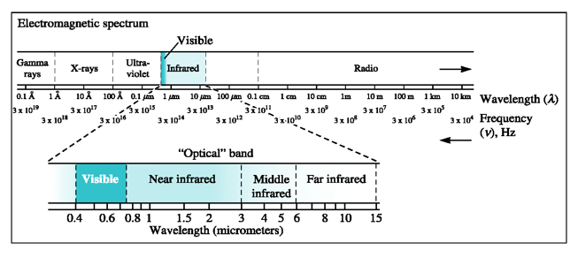
Electromagnetic spectrum

Slide 14
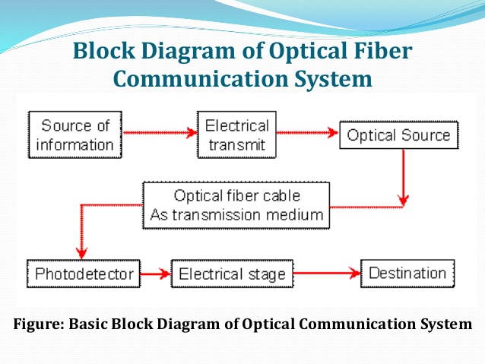
Fiber Optic Communication
The process of communicating using optical fiber involves the following steps.
Creating the optical signal using a transmitter
Relaying the signal along the fiber ,ensuring that the signal does not become too distorted or weak
And receiving the optical signal and converting it in to an electrical signal.

Slide 15
Areas of application
Tele Communications
Local Area Networks
Cable TV
CCTV
Optical fiber Sensors

Slide 16
Advantages of Fiber Optic Communication
High information carrying capacity
Low attenuation
Greater Safety
Immunity to radiofrequency and electromagnetic Interference
Higher Security
Small Size and Light Weight

